Slide 1
Gender Recognition by Voice
Project Term
INSAID NOV 19 BATCH
Sheetal Kumari

Slide 2
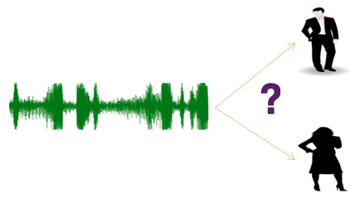
Gender Recognition by Voice and Speech Analysis
Problem Statement:
To make an algorithm which will predict the gender based on voices.
The Voice Data Set with 3168 Rows and 21 Columns
Containing one column “Label”
which is to be our Target Variable with
Female : 1583
Male : 1583

Slide 3
Dataset Description
Gender Recognition by Voice and Speech Analysis
This database is created to identify a voice as male or female, based upon acoustic properties of the voice and speech.
The dataset consists of 3,168 recorded voice samples, collected from male and female speakers.
The voice samples are already pre-processed with an analyzed frequency range of 0hz-280hz (human vocal range).
The data is already scaled with no null values.
It has duplicate rows which has to be removed

Slide 4
Exploring the Data
By exploraing the data we found:
21 Numerical (float) and 1 categorical value.
Few columns are highly corelated with each other; such columns need to be removed.

Slide 5
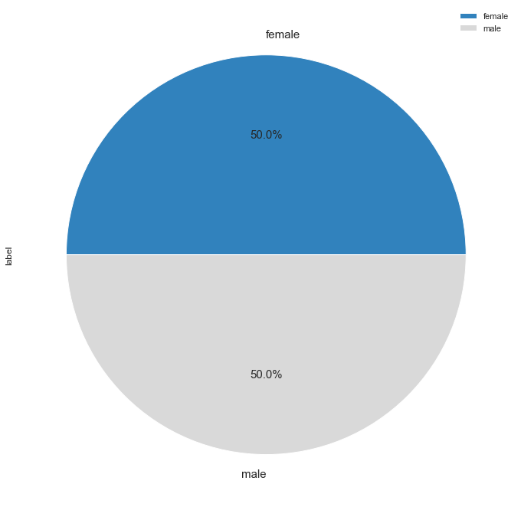
Can see there are equal number of Male & Female Population
50%
50%

Slide 6
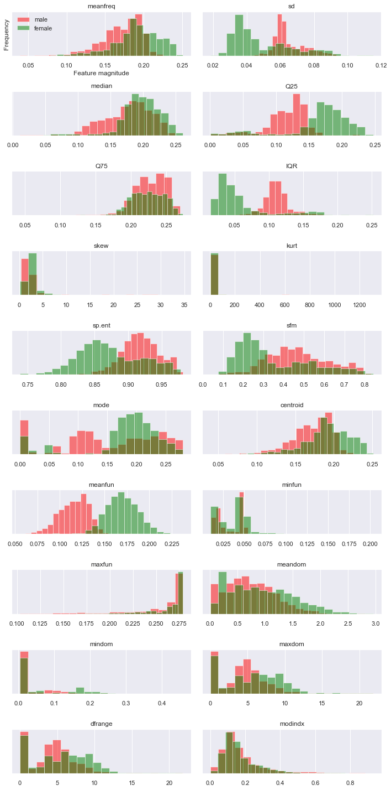
Graph shows the variation in voices for male and female.
Ranges is high for female voice.
Frequency of male voice is high.

Slide 7
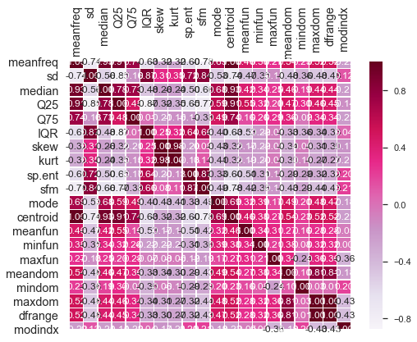
Heat map helps to identify the correlation between columns.
Removed few columns which has correlation beyond the range -0.8 to 0.8.

Slide 8
Logistic Regression
Classification Report
 | Precision | Recall | F1-score | Support
0 | 0.87 | 0.81 | 0.84 | 309
1 | 0.83 | 0.89 | 0.86 | 325
Accuracy |  |  | 0.85 | 634
Macro Avg | 0.85 | 0.85 | 0.85 | 634
Weighted Avg | 0.85 | 0.85 | 0.85 | 634
Confusion Matrix
 | Predicted Male | Predicted Female
Actual Male | 249 | 60
Actual Female | 37 | 288

Slide 9
Decision Tree
Classification Report
 | Precision | Recall | F1-score | Support
0 | 0.96 | 0.95 | 0.96 | 309
1 | 0.95 | 0.97 | 0.96 | 325
Accuracy |  |  | 0.96 | 634
Macro Avg | 0.96 | 0.96 | 0.96 | 634
Weighted Avg | 0.96 | 0.96 | 0.96 | 634
Confusion Matrix
 | Predicted Male | Predicted Female
Actual Male | 293 | 16
Actual Female | 11 | 314

Slide 10
Decision Tree Grid Search
Classification Report
 | Precision | Recall | F1-score | Support
0 | 0.96 | 0.95 | 0.96 | 309
1 | 0.95 | 0.97 | 0.96 | 325
Accuracy |  |  | 0.96 | 634
Macro Avg | 0.96 | 0.96 | 0.96 | 634
Weighted Avg | 0.96 | 0.96 | 0.96 | 634
Confusion Matrix
 | Predicted Male | Predicted Female
Actual Male | 290 | 19
Actual Female | 7 | 318

Slide 11
Random Forest
Classification Report
 | Precision | Recall | F1-score | Support
0 | 0.99 | 0.96 | 0.98 | 309
1 | 0.97 | 0.99 | 0.98 | 325
Accuracy |  |  | 0.98 | 634
Macro Avg | 0.98 | 0.98 | 0.98 | 634
Weighted Avg | 0.98 | 0.98 | 0.98 | 634
 | Predicted Male | Predicted Female
Actual Male | 298 | 11
Actual Female | 4 | 321
Confusion Matrix

Slide 12
KNN
Classification Report
 | Precision | Recall | F1-score | Support
0 | 0.82 | 0.77 | 0.79 | 309
1 | 0.79 | 0.84 | 0.82 | 325
Accuracy |  |  | 0.81 | 634
Macro Avg | 0.81 | 0.81 | 0.81 | 634
Weighted Avg | 0.81 | 0.81 | 0.81 | 634
Confusion Matrix
 | Predicted Male | Predicted Female
Actual Male | 238 | 71
Actual Female | 52 | 273

Slide 13
SVM
Classification Report
 | Precision | Recall | F1-score | Support
0 | 0.98 | 0.92 | 0.95 | 309
1 | 0.93 | 0.98 | 0.96 | 325
Accuracy |  |  | 0.95 | 634
Macro Avg | 0.95 | 0.95 | 0.95 | 634
Weighted Avg | 0.95 | 0.95 | 0.95 | 634
 | Predicted Male | Predicted Female
Actual Male | 285 | 24
Actual Female | 6 | 319
Confusion Matrix

Slide 14
Naive Bayes
Classification Report
 | Precision | Recall | F1-score | Support
0 | 0.86 | 0.87 | 0.87 | 309
1 | 0.88 | 0.87 | 0.87 | 325
Accuracy |  |  | 0.87 | 634
Macro Avg | 0.87 | 0.87 | 0.87 | 634
Weighted Avg | 0.87 | 0.87 | 0.87 | 634
Confusion Matrix
 | Predicted Male | Predicted Female
Actual Male | 269 | 40
Actual Female | 43 | 282

Slide 15
Final Report
Logistic Regression:
Accuracy = 0.8470031545741324
Processing Time = 0.0625
Decision Tree:
Accuracy = 0.9574132492113565
Processing Time = 0.078125
Decision Tree Grid Search:
Accuracy = 0.9589905362776026
Processing Time = 102.40625
Random Forest:
Accuracy = 0.9763406940063092
Processing Time = 0.203125
KNN:
Accuracy = 0.805993690851735
Processing Time = 0.109375
SVM:
Accuracy = 0.9526813880126183
Processing Time = 0.546875
Naive Bayes:
Accuracy = 0.8690851735015773
Processing Time = 0.046875

Slide 17
Conclusion
We have compared the performance of the all models using various model evaluation techniques.
As per the Report Random Forest has highest accuracy 97% within 0.2 seconds.

Slide 18
Thank You

